Slide 1
When to model description class?
A description class contains information that describes something else

Slide 2
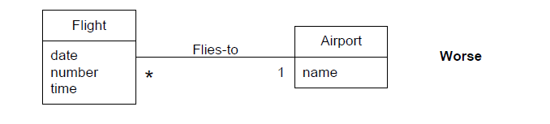
Description class

Slide 3
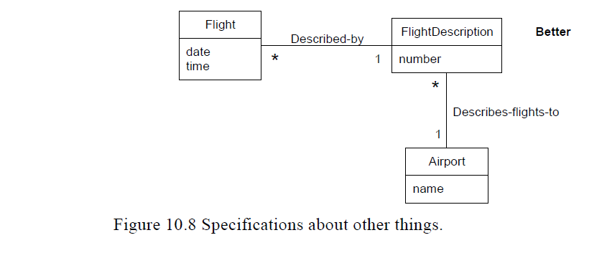

Slide 4
DOMAIN MODEL REFINEMENT
Refine the domain model with generalization ,specialization, association classes, time intervals ,composition and packages.
Identify when showing a subclass is worthwhile.

Slide 5
Generalization is the activity of identifying commonality among concepts and defining general concept and specialized concept relationships.
It is a way to construct taxonomic (arrangement) classifications among concepts
which are then illustrated in class hierarchies

Slide 6
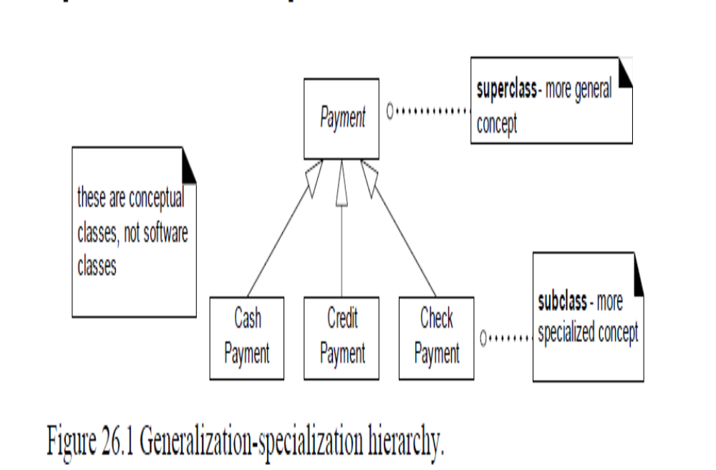

Slide 7
Generalization & CC
General-Conceptual superclass
Specialized-Conceptual subclass
Not of software superclass and sub class

Slide 8
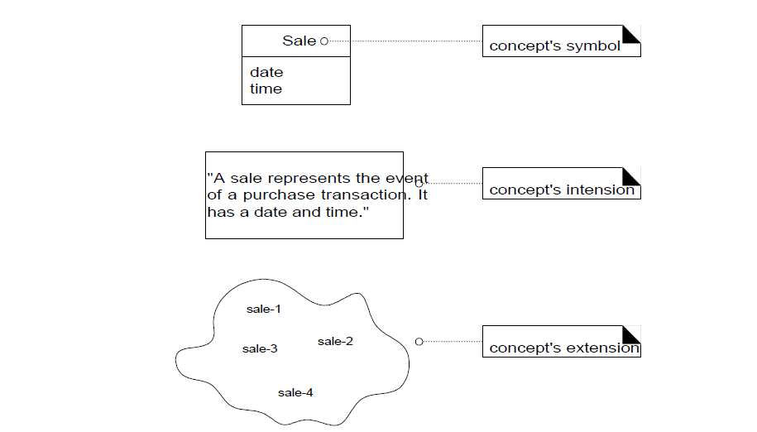

Slide 9
Conceptual
Idea
Thing
Object
Explained in terms of symbol, intension and extension

Slide 10
Conceptual class Symbol –Superclass
Intension-Super class is more general or encompassing(include) than a subclass definition.

Slide 12
In above, payment is transfer of money
Credit payment –pay through credit.

Slide 13
Extension-All members of conceptual subclass set are members of their superclass set.

Slide 14
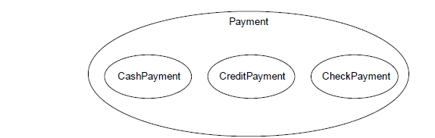

Slide 15
Conceptual subclass definition conformance
When class hierarchy is created,statements about superclasses that apply to subclasses are made.

Slide 16
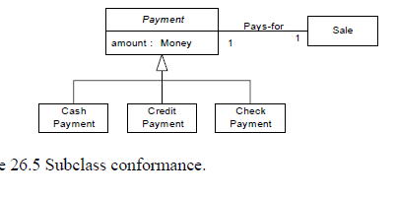
Conceptual subclass definition conformance

Slide 17
All payments have an amount and are associated with a sale.

Slide 18
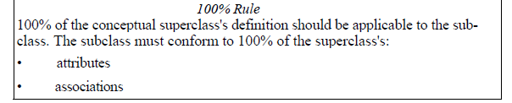

Slide 19
Conceptual subclass set conformance
A conceptual subclass should be a member of the set of the super class.

Slide 20
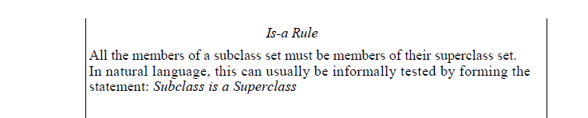

Slide 21
Conceptual subclass
Subclass should conform
100% rule(defn conformance)
Is a Rule (Set membership conformance)

Slide 22
When to design Conceptual subclass
Conceptual class partition is a division of a conceptual class into disjoint subclasses.

Slide 23
Motivations to Partition a Conceptual Class into Subclasses
The following are strong motivations to partition a class into subclass:
Create a conceptual subclass of a superclass when:
1. The subclass has additional attributes of interest.
2. The subclass has additional associations of interest.
3. The subclass concept is operated on, handled, reacted to, or manipulated differently than the superclass or other subclasses, in ways that are of interest.
4. The subclass concept represents an animate thing (for example, animal, robot) that behaves differently than the superclass or other subclasses,in ways that are of interest.

Slide 24
When to define conceptual superclass
Commonality is identified among potential subclasses.

Slide 25
The following are motivations to generalize and define a superclass
:
Create a conceptual superclass in a generalization relationship to subclasses when the potential conceptual subclasses represent variations of a similar concept.
• The subclasses will conform to the 100% and Is-a rules.
• All subclasses have the same attribute which can be factored out and expressed in the superclass.
• All subclasses have the same association which can be factored out and related to the superclass.

Slide 26
Abstract CC
If every member of class C must also be member of a subclass ,then class C is called an abstract conceptual class

Slide 27
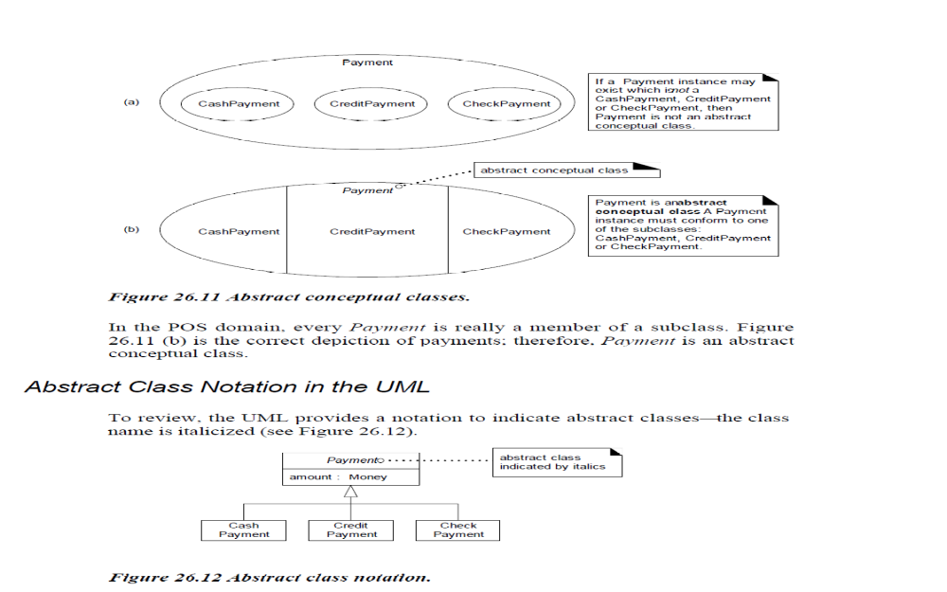

Slide 28
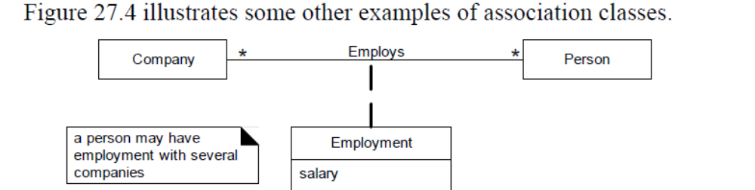
Association class

Slide 29
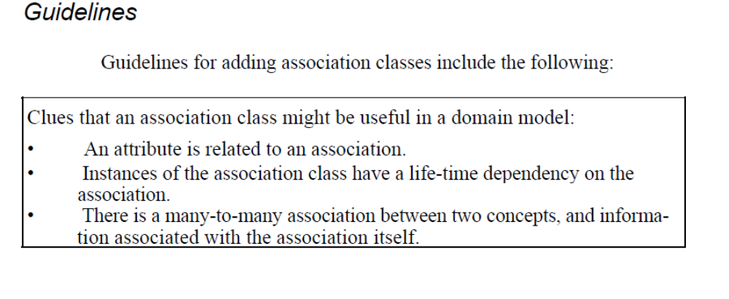

Slide 30
When to show composition?
Life time of the part is bound within the lifeltime of the composite
There is an obvious whole-part relationships.
Some properties and operation of the composite propagate to the parts

Slide 31
It implies
An instance of the part belongs to only one composite instance at a time.
Part must always belong to only one composite instance
The composite is responsible for creation and deletion of its parts

Slide 32
Product catalog contains product description
Sale contains salelineitem

Slide 33
Reflexive Association
Association to itself.

Slide 34
Qualified Associations
IT has a qualifier that is used to select an object from a larger set of related objects.
Product catalog contains many ProductDecriptions and each one can be selected by an Item Id

Slide 35
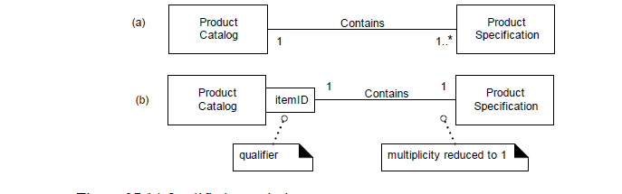

Slide 36
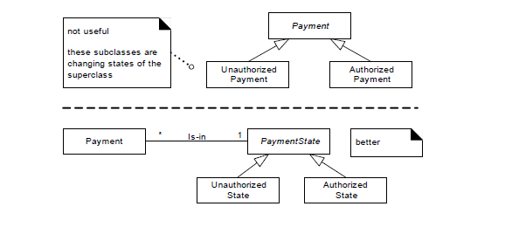

Slide 37
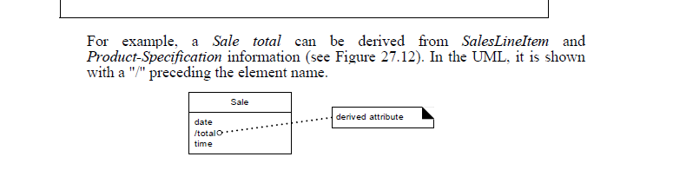

Slide 38
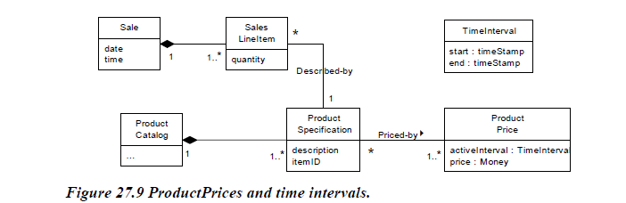

Slide 39
Association
package

